Slide 1

SRM-NIRS-EEG Update 11/3
Benjamin Richardson

Slide 2
EEG raw spectrograms (no baselining) split up

Slide 3
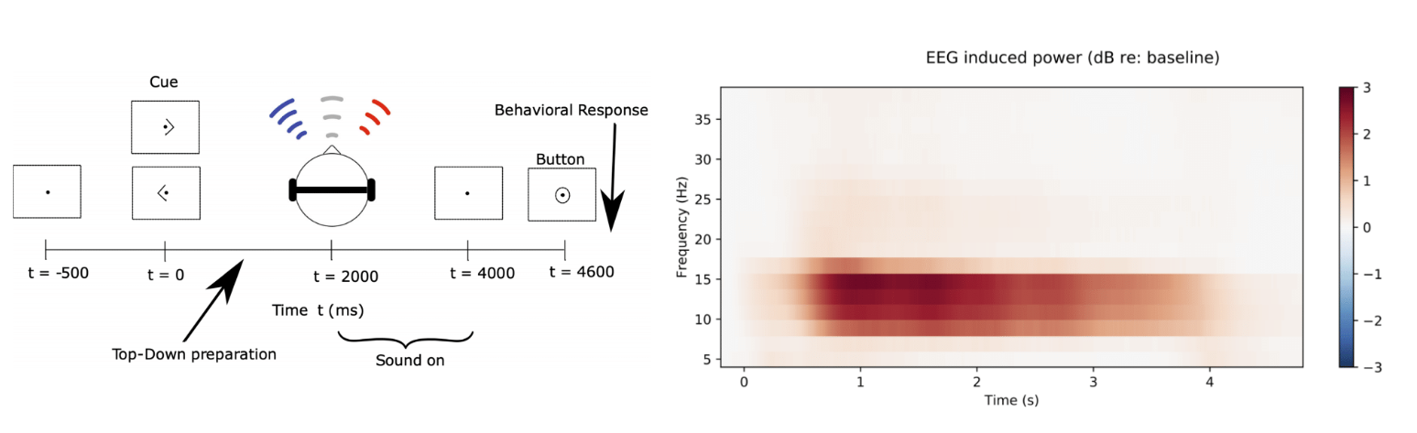

Slide 4
Spectrograms just ITD500

Slide 5
cont

Slide 7
Spectrograms with ERP subtracted

